Slide 1
Nourriture - Connect People with Ingredients
fastDev@HTML5+jQuery
Beijing Jiao Tong University

Slide 2
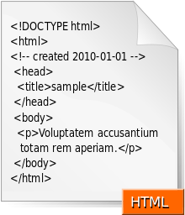
What HTML
HyperText Markup Language is the standard markup language used to create web pages.
HTML is written in the form of HTML elements consisting of tags enclosed in angle brackets (like <html>)
A web browser can read HTML files and compose them into visible or audible web pages, and can also refer to Cascading Style Sheets (CSS) to define the look and layout of text and other material.
The filename extension is .html or .htm and the internet media type is text/html
Beijing Jiao Tong University

Slide 3
What Internet Media Type
An Internet media type (MIME types or Content-types) is a standard identifier used on the Internet to indicate the type of data that a file contains.
web browsers use them to determine how to display or output files that are not in HTML format
Types of media type include application, text, audio, image, video, message, model, multipart,
top-level type name / subtype name [ ; parameters ]
application/xhtml+xml
top-level type name / [ tree. ] subtype name [ +suffix ] [ ; parameters ]
application/vnd.ms-excel
Beijing Jiao Tong University

Slide 4
History of HTML
HTML -> XHTML -> HTML5
Beijing Jiao Tong University

Slide 5


HTML History
HTML Tag (1.0) The Draft
HTML 2.0 1995 IETF (Internet Engineering Task Force)
HTML 3.2 1997 W3C (World Wide Web Consortium)
HTML 4.0 1997
HTML 4.0.1 1999
…
HTML 5.0 2014
What Happened
Strict vs. Transitional: developer vs. designer
The HTML 4.0 standard included two different forms of frame, frame element, used inside a special frameset container, and the iframe element, used within the body of a document. The feature has been removed from the HTML5 standard.
Beijing Jiao Tong University

Slide 6


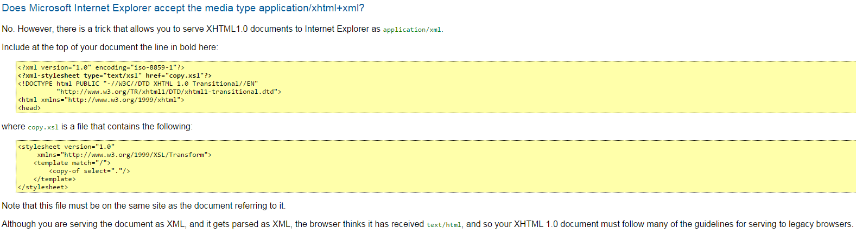
HTML to XHTML
XHTML 1.0 2000 Same three variations as HTML 4.0 and 4.01
Validator
Attributes, Elements, Attributes Values to be quoted, Close tags
.HMTL and .XML
3 variants
XHTML 1.1 2001 Based on XHTML 1.0 Strict
.XML Only
XHTML 2.0 2009 The Draft (abandoned)
Beijing Jiao Tong University

Slide 7
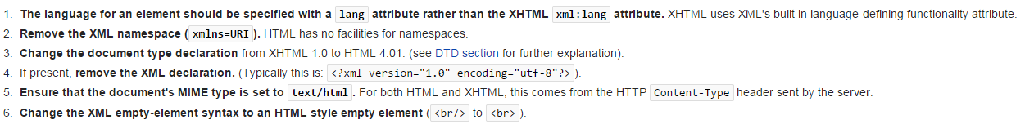
SGML-based vs. XML-based HTML
The W3C intended (X)HTML 1.0 to be identical to HTML 4.01
Like HTML 4.01, XHTML 1.0 has three sub-specifications: strict, transitional and frameset.
REVERSE: Transformation of a valid and well-formed XHTML 1.0 document into a valid HTML 4.01 document by below main changes:
Beijing Jiao Tong University
Notes:
SGML stands for Standard Generalized Markup Language

Slide 8
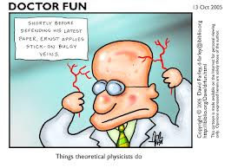
Why XHTML Not Popular (Doctor Fun)
XHTML 1.1 – Serve the document as XML
IE Not support application/xhtml+xml very well
Change the Internet Media Type from text/html to application/xhtml+xml
The Error Handling Model of XML that when the parser comes across an error, stop parsing
XHTML 2.0 - Break backwards compatibility
Break backwards compatibility with existing versions of HTML 4.0 and 4.0.1 and XHTML1.1, it is new language
Thanks to XML and stylesheets, such strict element-wise backwards compatibility is no longer necessary, since an XML-based browser can process new markup languages without having to be updated.
Intent to use object element (multi src) to deprecate the img element
The intentions is good, but it break the compatibility
Beijing Jiao Tong University

Slide 9

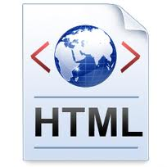


Robustness Principle
Be conservative in what you send;
Be liberal in what you accept
-- Postel’s Law (伯斯塔尔法则)
Browser Makers
Developers/Designers/…
Beijing Jiao Tong University

Slide 10
Get to HTML5
WHATWG -> W3C -> HTML5
Beijing Jiao Tong University

Slide 11

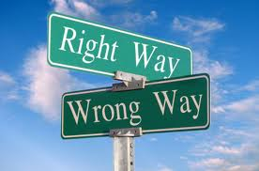

HTML5 Appearance
2004
2006
2007
XHTML 2.0 or
Extend HTML
Tim Berners-Lee: ‘We were wrong’
HTML5 working group
XHTML 2.0
World Wide Web Consortium
Extend HTML
Extend HTML
Extend HTML
Web Hypertext Applications Technology Working Group
Beijing Jiao Tong University

Slide 12
W3C vs. WHATWG
Same
Difference
HTML5 Specifications
HTML Design Principles
World Wide Web Consortium
HTML5 Specifications
Plain HTML / Web Technologies
Web Hypertext Applications Technology Working Group
Beijing Jiao Tong University

Slide 13
HTML5 Typical Characteristics
Simplicity (Straightforward)
HTML 4.0.1
More
<!DOCTYPE html PUBLIC "-//W3C/DTD HTML 4.01//EN""http://www.w3.org/TR/html4/strict.dtd">
<meta charset="utf-8">
<link ref=“stylesheet” type=“text/css” href=“file.css”>
<script type=“text/javascript”> </script>
XHTML 1.0
<!DOCTYPE html PUBLIC "-//W3C/DTD XHTML 1.0 Strict//EN""http://www.w3.org/TR/xhtml1/DTD/xhtml1-strict.dtd">
HTML5
<!DOCTYPE html>
Beijing Jiao Tong University

Slide 14


HTML5 Typical Characteristics
Flexibility (DOM tree)
HTML5
<img src="foo" alt="bar" />
<p class="foo">Hello world</p>
<img src="foo" alt="bar">
<p class="foo">Hello world
<IMG SRC="foo" ALT="bar">
<P CLASS="foo">Hello world</P>
<img src=foo alt=bar>
<p class=foo>Hello world</p>
Beijing Jiao Tong University

Slide 15

HTML5 Typical Characteristics
Pragmatic
(X)HTML
<h2><a href="/path/to/resource">Headline text</a></h2>
<p><a href="/path/to/resource">Paragraph text.</a></p>
HTML5
Wrap whole thing in one element
<a href="/path/to/resource">
<h2>Headline text</h2>
<p>Paragraph text.</p>
</a>
Beijing Jiao Tong University

Slide 16
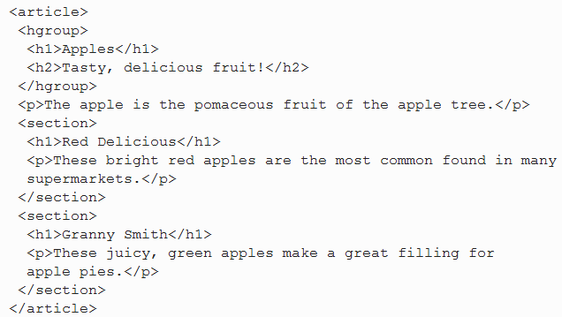
HTML5 Typical Characteristics
Convenience
HTML5
Sectioning content, and use h1 elements throughout, without having to worry about whether a particular section is at the top level, the second level, the third level, and so on
Beijing Jiao Tong University

Slide 17
HTML5 Typical Characteristics
Adaptability
HTML5
<video>
<source src="movie.mp4">
<source src="movie.ogg">
<object data="movie.swf">
<a href="movie.mp4">download</a>
</object>
</video>
It’s a good idea to hedge your bets and serve up your video both ways (video and flash)
Beijing Jiao Tong University

Slide 18
HTML5 Typical Characteristics
Get More…
HTML5
http://www.w3.org/TR/html5/index.html#contents
Beijing Jiao Tong University

Slide 19





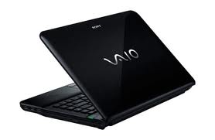
HTML5 Basic Principles
HTML, CSS, DOM, and JavaScript
Reduce external dependence , like Flash
Better error handling
More markup to replace scripting
Device independent
<Canvas> <video> <Audio> etc
Beijing Jiao Tong University

Slide 20
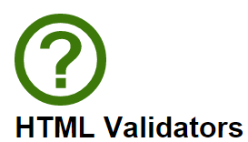

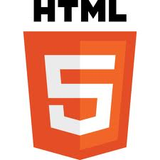
HTML5 Readiness Checking
HTML5 Validator
HTML5 Mobile
https://validator.whatwg.org/
http://mobilehtml5.org/
Modern Desktop Browser and Mobile Browser Support HTML5 Applications.
Beijing Jiao Tong University

Slide 21
Takeaways
Design Principle:
In case of conflict: consider users over authors over implementors over specifiers over theoretical purity.
-- Jeremy Keith
https://github.com/adactio
Beijing Jiao Tong University

Slide 22
jQuery Manipulates DOM
Beijing Jiao Tong University

Slide 23
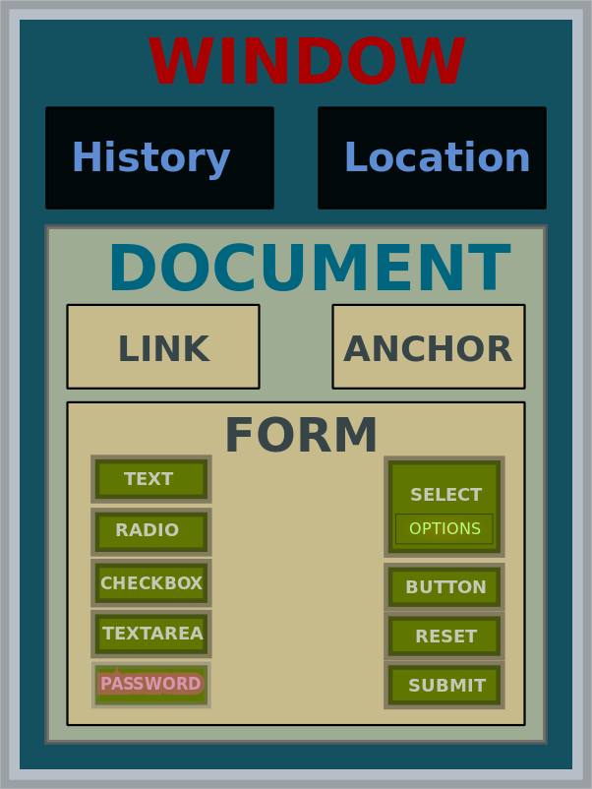
What DOM
The Document Object Model (DOM) is a cross-platform and language-independent convention for representing and interacting with objects in HTML, XHTML and XML documents.
The nodes of every document are organized in a tree structure, called the DOM tree.
Beijing Jiao Tong University

Slide 24
DOM History
DOM Level 0 1995
JavaScript @Netscape and JScript @Microsoft
DOM Level 1 1997
ECMAScript by W3C, and enabled in browser
DOM Level 2 2000
The function getElementById
Event model, especially for mouse event handling
Support for XML namespaces and CSS
DOM Level 3 2004
XPath is a query language for selecting nodes from an XML document
Keyboard event handling
DOM Level 4 2014 The Draft
More event handling
…
Beijing Jiao Tong University
Notes:
ECMAScript is the scripting language standardized by Ecma International in the ECMA-262 specification and ISO/IEC 16262. The language is widely used for client-side scripting on the web, in the form of several well-known implementations such as JavaScript, JScript and ActionScript.
Ecma (European Computer Manufacturers Association (ECMA) ) International is an international, private (membership-based) non-profit standards organization for information and communication systems.

Slide 25
What jQuery
jQuery is a fast, small, and feature-rich JavaScript library. It makes things like HTML document traversal and manipulation, event handling, animation, and Ajax much simpler with an easy-to-use API that works across a multitude of browsers.
Beijing Jiao Tong University

Slide 26
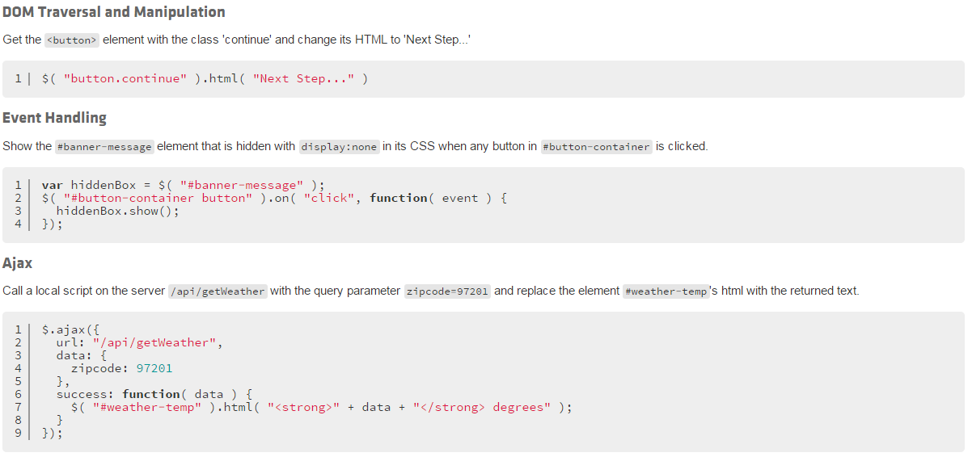
jQuery A Brief Look
Beijing Jiao Tong University

Slide 27
Other jQuery Foundation Projects
jQuery UI is a curated set of user interface interactions, effects, widgets, and themes built on top of the jQuery JavaScript Library.
jQuery Mobile is a HTML5-based user interface system designed to make responsive web sites and apps that are accessible on all smartphone, tablet and desktop devices.
Beijing Jiao Tong University

Slide 28
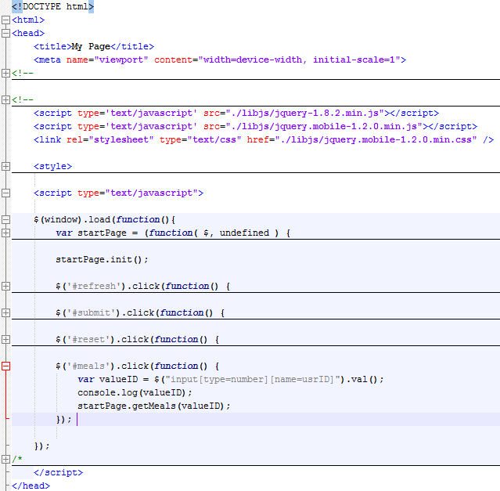
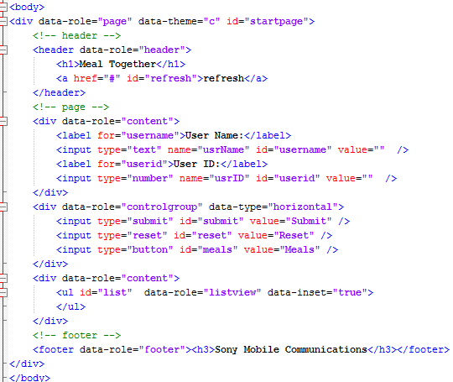
Get Started with jQuery Mobile
Beijing Jiao Tong University

Slide 29
Reference
http://www.w3.org/TR/html5/
https://developers.google.com/web-toolkit
https://developer.mozilla.org
http://diveintohtml5.info/introduction.html
http://en.wikipedia.org/wiki/HTML
http://en.wikipedia.org/wiki/Internet_media_type
http://en.wikipedia.org/wiki/DOM_events
http://en.wikipedia.org/wiki/ECMAScript
http://diveintohtml5.info/introduction.html
http://jquery.com/
http://www.iana.org/assignments/media-types/media-types.xhtml
Beijing Jiao Tong University

